Slide 1
ReCell
Supervised Learning, PGP - Data Science and Business Analytics Arsalaan B. Saiyed
Date – 13th May 2022

Slide 2
Contents / Agenda
Executive Summary
Business Problem Overview and Solution Approach
Data Background and Contents
EDA Results
Data Preprocessing
Model Performance Summary
Appendices
Appendix-A: EDA Results
Appendix-B: Model Performance Summary

Slide 3
Executive Summary
Our study reveals that the used price of the phone is primarily dependent on the following:
Price of new device
Years since release (inversely proportional)
os - Operating system (inversely proportional)
ram - Processing speed
Main camera & front camera
Weight
Based on the above findings from the given data we can provide the following insights and recommendations business up:
The original price of the devices plays a huge role in the price of the used devices ReCell should aim to acquire as many devices that have a high market prices. For example, Apple, Oneplus and Google products are higher in quality and high in performance which can be bought at lower rates, refurbished and sold at comparatively higher prices than other brands.
The older the product is the more outdated it gets and depreciates in value. Therefore, ReCell is much more likely to have success selling more recent phones/tablets at a competitive prices. Similarly, the lesser the device was previously used the better.
Our model suggest that the ram and operating system of the device also contributes to the used price of the product. Any product which does not operate on android, IOS or windows is likely to have poor demand and resale value. Customers prefer faster devices so devices with lesser than 4gb ram are unlikely to be in demand.
It is no surprise customers constantly want better quality camera. Better the camera quality the better the resale prices.

Slide 4
Executive Summary
ReCell can hold ad campaigns to target customer based on their needs and divide them into segments. And based on the demand in those segments they can stock up on the best devices at competitive prices.
Heavier phones tend to be priced higher as well probably because it gives a feeling of high quality. So devices with larger batteries would tend to be heavier hence, sell better.
A include more columns few recommendations from outside the data:
We can in to our database as business grows over the years for better prediction. We can ask customers for ratings for things such as overall satisfaction of the used device, used price fairness: which rates how much do they feel the price for the used device is fair.
Market research on what makes people buy new devices because that drives people selling their old devices. Usually, people buy new devices for the following reasons:
It was lost, turned faulty or was damaged – This is not a useful factor
Devices with significantly better features came out – Tech enthusiasts always want the next best thing so we can capitalize with the devices that they let go off too early by buying from them and selling them to everyday people looking for a new device or a simple upgrade.
ReCell can partner up with big brands to get certified technicians that repair/refurbish old devices for ReCell and can be sold as a certified distributor.

Slide 5
Business Problem Overview and Solution Approach
Problem Overview:
The market for used and refurbished phones and tablets has been forecasted to grow with a compound annual growth rate (CAGR) of 13.6%. This growth can be attributed to an uptick in demand for used phones and tablets that offer considerable savings compared with new models.
The objective is to provide an ML-based solution. To help ReCell tap in to the potential in this market we have built a linear regression model to predict the price of a used phone/tablet and to identify factors that significantly influence it.
Solution Approach:
Data Overview & EDA
Data pre-processing
Linear Regression Model Building
Test of linearity & Final Model Summary
Executive Summary - Actionable insights and summary

Slide 6
Data Background and Contents
Initial Observations:
Data was formatted appropriately.
Some of the data was missing for the columns highlighted in red, refer Table 2.
All rows in the data were unique which means there was data for 3454 unique phones/tablets of 34 unique phone/tablet brands and 4 different operating systems.
Observations | Variables
3454 | 15
Table 1: Shape of the data
Variable | Description
brand_name | Name of manufacturing brand
os | OS on which the device runs
screen_size | Size of the screen in cm
4g | Whether 4G is available or not
5g | Whether 5G is available or not
main_camera_mp | Resolution of the rear camera in megapixels
selfie_camera_mp | Resolution of the front camera in megapixels
int_memory | Amount of internal memory (ROM) in GB
ram | Amount of RAM in GB
battery | Energy capacity of the device battery in mAh
weight | Weight of the device in grams
release_year | Year when the device model was released
days_used | Number of days the used/refurbished device has been used
normalized_new_price | Normalized price of a new device of the same model in euros
normalized_used_price | Normalized price of the used/refurbished device in euros
Table 2: Details

Slide 7
EDA Results – Univariate Analysis
Upon conducting a univariate analysis of the raw data and computing the statistical summary we observed the following:
Normalized new price is found to be at a mean of Euro 5.23
Normalized used price is found to be at a mean of Euro 4.36
Most of the devices run on an Android operating systems
Most devices are 4g compared to 5g
Many older devices are not sold
Most devices,502 to be exact are from brand name ‘others’ meaning the brand was unknown at the time of the data sourcing. The 2nd and 3rd most devices are from the brands Samsung and Huawei respectively.
Note: The mean, min, max etc. for all columns are given in the statistical summary in a table in Appendix-A
Link to Appendix slide on data background check

Slide 8
EDA Results – Bivariate Analysis
Upon conducting a bivariate analysis of the raw data we observed the following:
From the heatmap we can see that lot of device features have a positive correlation with the used prices.
Days used/release year i.e. the age of the devices have a negative correlation with the used prices.
We observe the wide range of variability of features across brand names.
Some customers specifically look for good front cameras to click cool selfies. According our data Huawei, Vivo and Oppo offer most devices with front facing cameras with more than 8 megapixels
Some customers specifically look for good rear facing cameras to click cool selfies. According our data Sony and Motorola offer most devices with rear cameras with more than 16 megapixels.
For customers that prefer high quality both rear and front cameras can go with Sony or HTC
Customers that prefer to use devices mainly for entertainment or creative purposes prefer a larger screen size. They could go with brands such as Huawei and Samsung that provide the most devices with screens bigger than 6 inches.
Some customer need faster processing speed for this they can go for brands like Samsung, Oppo and Huwaei for rams greater than 8gb.
Link to Appendix slide on data background check

Slide 9
Data Preprocessing
Duplicate value check
Missing value treatment
Outlier check (treatment if needed)
Feature engineering
Data preparation for modeling
Note: All pre-processing was carried out while conducting business sense checks along each step.

Slide 10
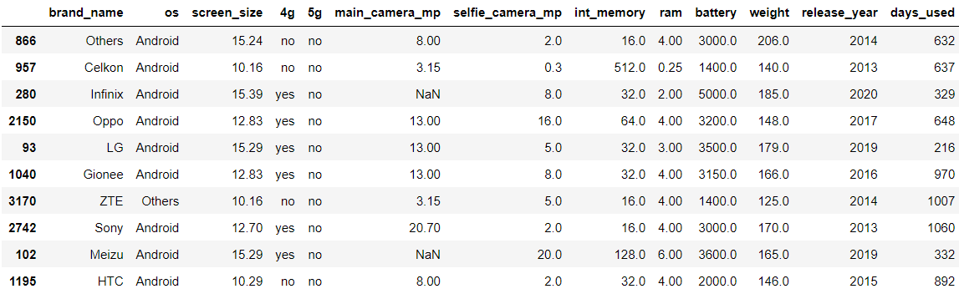
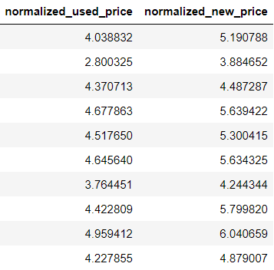
Data Preprocessing
Let’s take a quick look at a small sample of our data.
This will help us get some idea of the attributes of the data and also help us understand the degree of cleaning needed before we can build a model.
Duplicate Value Check: No duplicate entries were found in the given data
Random sample of the data:

Slide 11
Data Preprocessing
Missing Value Treatment:
Table below shows the number of missing values in all the columns in the given data. Upon analyzing them we conclude none of them can be dropped and are essential for the model building therefore, we will impute the data with their median.
Column | Missing Variable
main_camera_mp | 179
weight | 7
battery | 6
int_memory | 4
ram | 4
selfie_camera_mp | 2
brand_name | 0
os | 0
screen_size | 0
4g | 0
5g | 0
release_year | 0
days_used | 0
normalized_used_price | 0
normalized_new_price | 0
We first impute the missing data with the median of the data grouped by brand name and release year to consider brand as well as temporal factor.
Interestingly we find that not all the missing values are imputed and this is because for some brands there is no data available for certain columns for certain years.
Therefore, we impute the missing data once more with the median of the data but grouped by brand name only and this results in the complete treatment of the missing values.

Slide 12
Data Preprocessing
Outlier Check:
On reviewing the boxplots we can see a lot of variability throughout many of the features but this is a result if the wide range of specifications brands try to offer from low end just for day-to-day or minimal use or high end products tailored for high performance for customers looking for a top of the line product. Some such occurrences can be seen in the following:
Front and rear cameras with over 20 megapixels. Phones such as Nokia, ZTE and Motorola do in fact provide these features.
Internal memory over 500 GB is available in phones and tablets offered by brands such as Apple, Asus and Samsung
In conclusion, no outlier treatment is required as these are not miss entries or impossible values. It is crucial for our model building to factor in all features available in the market.

Slide 13
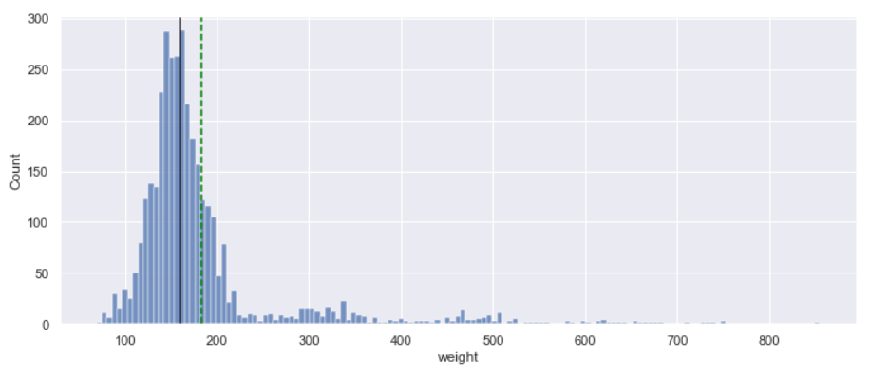
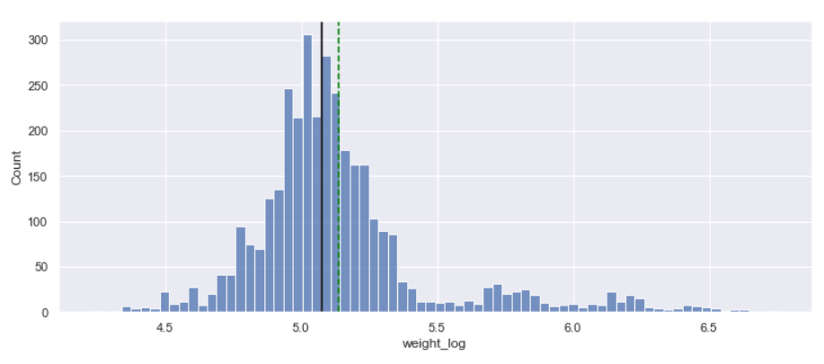
Data Preprocessing
Feature Engineering:
We create a new column years_since_release from the release_year column. We considered the year of data collection, 2021, as the baseline and then we dropped the release_year column.
The weight column is right skewed so to deal with this we using log transform to normalize the data. We create a new column called weight_log and drop the weight column. Refer graphs below
We create new columns for categorical columns like 4g, 5g, and os. We drop brand_name for our model as it doesn’t add any value to model.

Slide 14
Model Performance Summary
Overview of ML model and its parameters
Summary of steps and most important factors used by the ML model for prediction
Model Assumptions
Summary of key performance metrics for training and test data in tabular format for comparison
Note: You can use more than one slide if needed
Link to Appendix slide on model assumptions

Slide 15
Model Performance Summary
Overview of ML model and its parameters:
Our goal was to provide ReCell with a smart solution to help predict the prices of used devices that will enter the market in the future. For this we used past data of phones and tablets to build a machine learning model using simple linear regression.
Data was preprocessed and manually analyzed through EDA and treated for any inconsistencies. Statsmodel was used in python to build a model that fit the train data set and tested against the test data set. Then, the model was treated to meet all the linear regression assumptions.
Listed below is the equation for out linear model using the coefficients of the parameters from the final model that predicts the prices of used devices:

Slide 16
Model Performance Summary
Summary of steps and most important factors used by the ML model for prediction
We drop brand_name column and encode the other categorical data such as 4g, 5g & os.
Split the data into train and test data set in a 70:30 ratio, after splitting we got the following number of rows in train data = 2417 and the following number of rows in test data = 1037
The target variable is the normalized_used_price so we create new data frames ‘x’ and ‘y’ for independent and dependent variables separately.
We build are preliminary regression model using stats model and we observe a large condition number that indicates high multicollinearity and high p-values suggesting insignificant features in the model.
We test all the other conditions required to assume linearity. Refer model assumption section.
We review the results of the final model and compare the performance metrics such as R², Adj. R², Root mean squared error, mean absolute error and mean absolute percentage error.
Link to Appendix slide on model assumptions

Slide 17
Model Performance Summary
Model Assumptions: We test for linear regression assumptions and fix them:
Check for multicollinearity. Weight and screen_size were dropped. General Rule of thumb is:
1 < VIF <= 5: There is low multicollinearity
5 < VIF <= 10: There is moderate multicollinearity
VIF > 10: There is high multicollinearity
Multiple column with p-values>0.05 (the agreed upon confidence interval) were dropped
Then we test for linearity and independence of residuals.
We also tested for normality by checking the distribution of residuals, by checking the Q-Q plot of residuals, and by using the Shapiro-Wilk test.
Observations:
Since p-value < 0.05, the residuals are not normal as per the Shapiro-Wilk test.
However, based on the distribution plot and Q-Q plot, we can consider the distribution to be a good approximation of the normal distribution.
So, the assumption is satisfied.

Slide 18
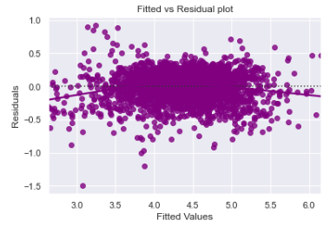
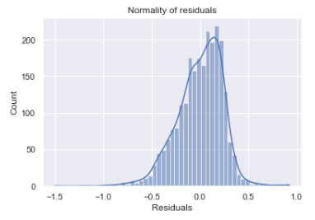
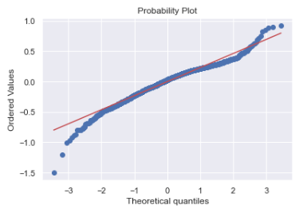
Model Performance Summary
We tested for homoscedasticity by using the goldfeldquandt test. We got a p-value greater than 0.05 hence, we can say that the residuals are homoscedastic.

Slide 19
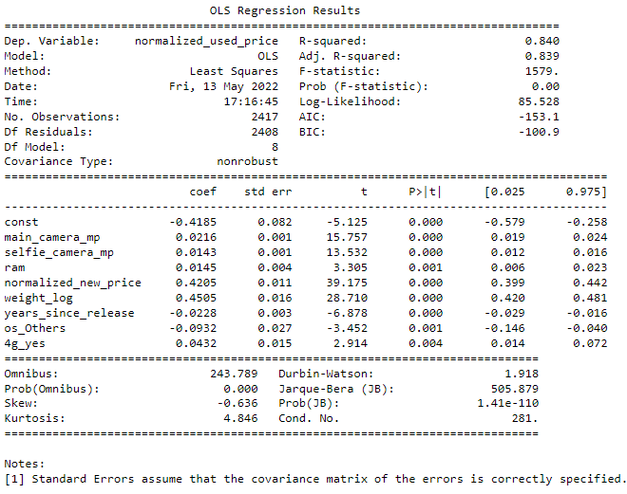


Model Performance Summary
Summary of key performance metrics for training and test data in tabular format for comparison:
The train and test 𝑅² are 0.839 and 0.842, indicating that the model explains 83.9% and 84.2% of the total variation in the train and test sets respectively. Also, both scores are comparable.
RMSE values on the train and test sets are also comparable. This shows that the model is not overfitting.
MAE indicates that our current model is able to predict anime ratings within a mean error of 0.18 on the test set.
MAPE of 4.47 on the test data means that we are able to predict within 4.47% of the used price.

Slide 20
APPENDIX – A : EDA Results

Slide 21
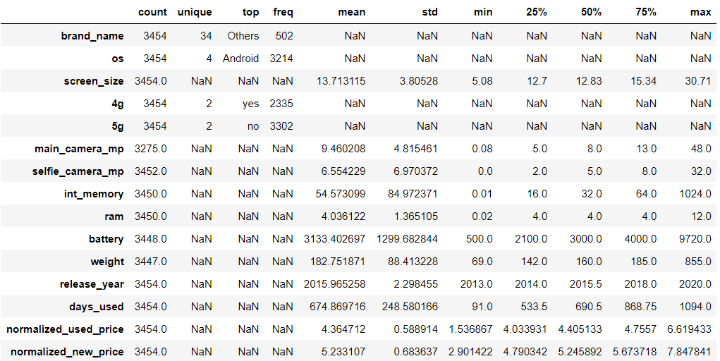
Statistical Summary of the data:

Slide 22
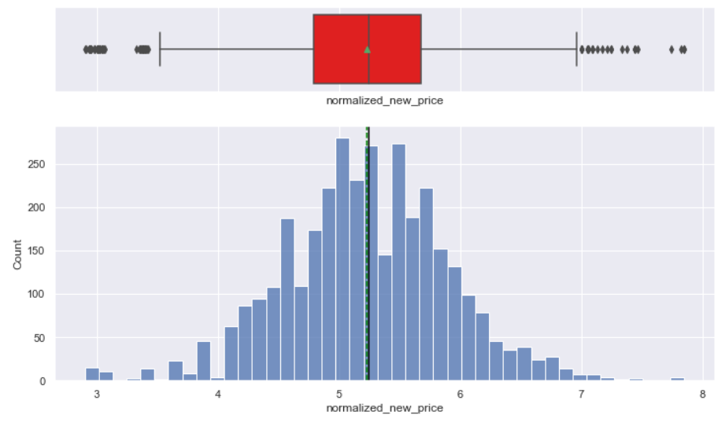
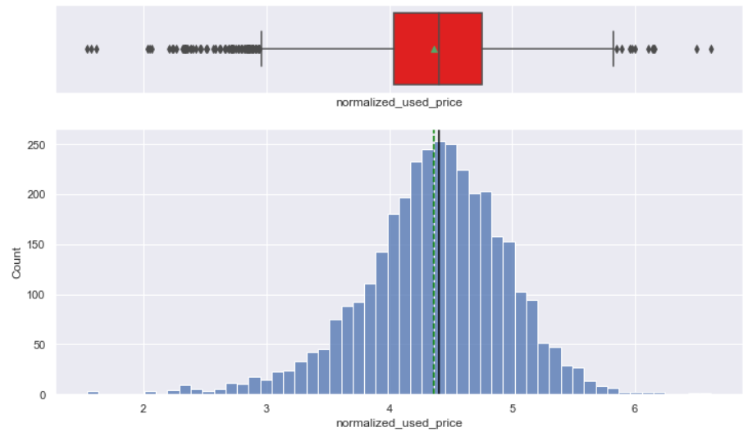
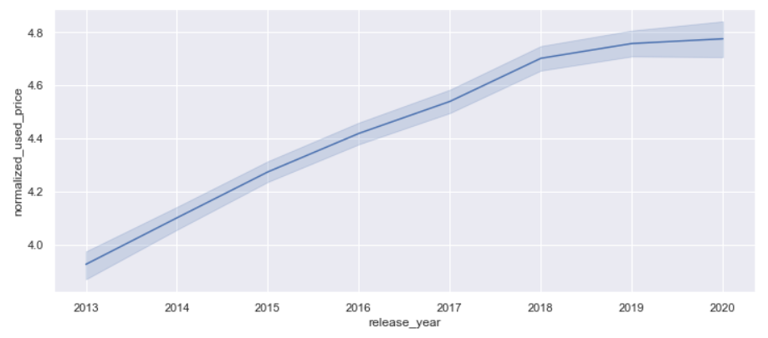
Distributions for normalized prices:

Slide 23
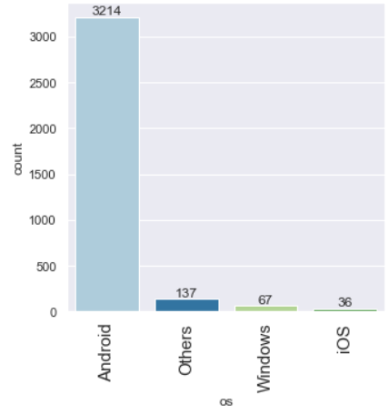
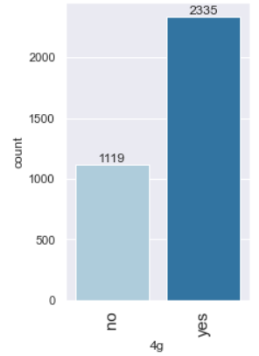
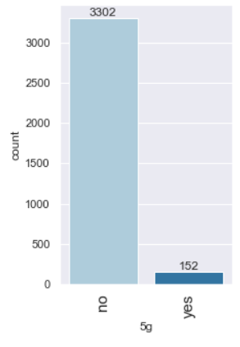
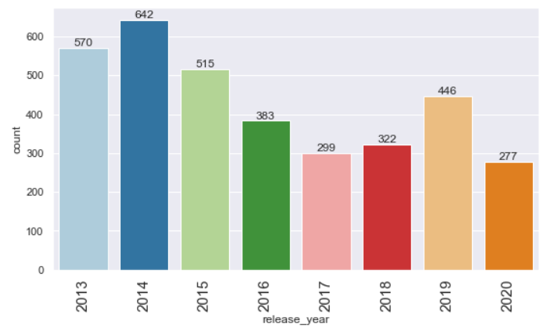
Distributions of counts for os, 4g, 5g and release year

Slide 24
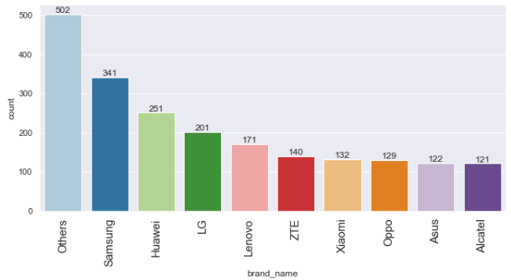
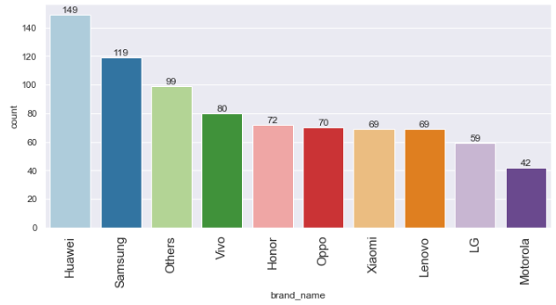
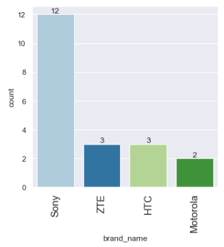
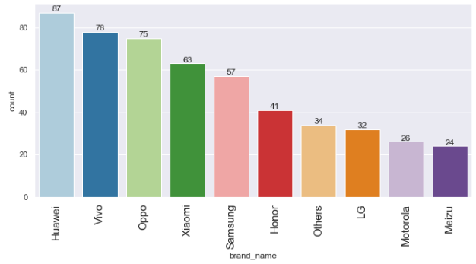
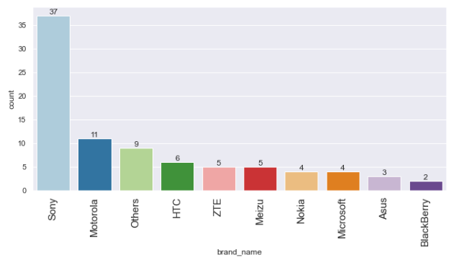
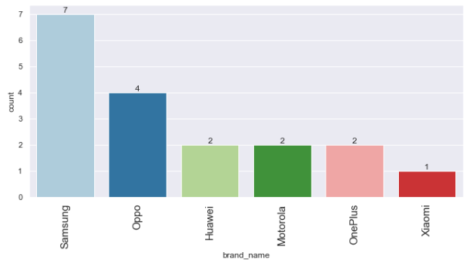
Brand-wise distribution (Top 10s)
Brand name count plot
Brands with devices with large screens
Brands with both good rear and front cameras
Brands with devices with good selfie cameras
Brands with devices with good rear cameras
Brands with larger rams

Slide 25
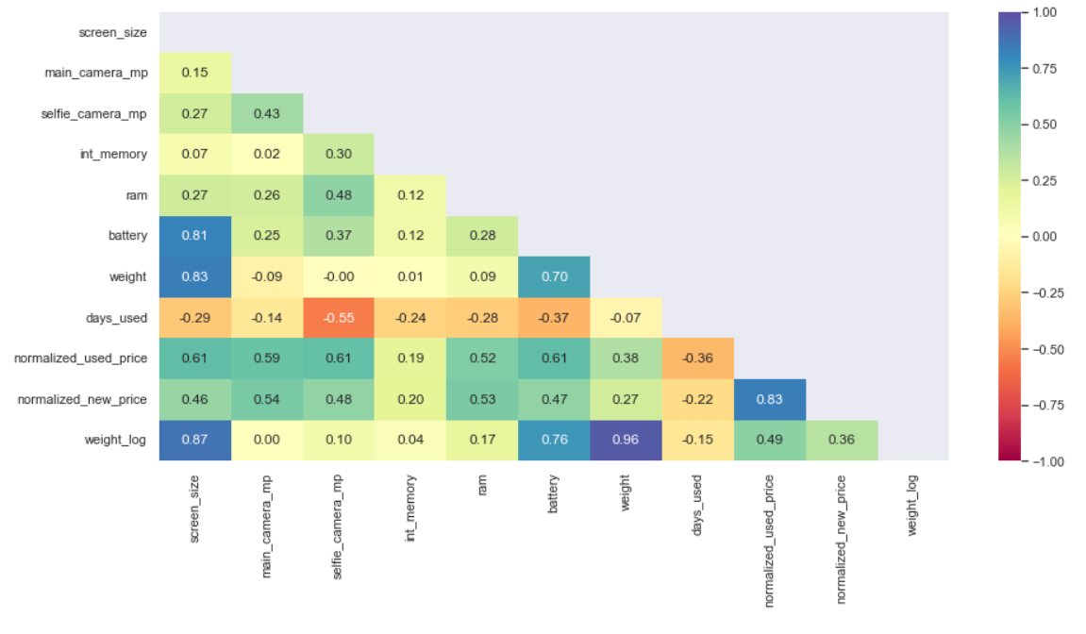
Heat Map

Slide 26
APPENDIX – B : Model Performance Summary

Slide 27
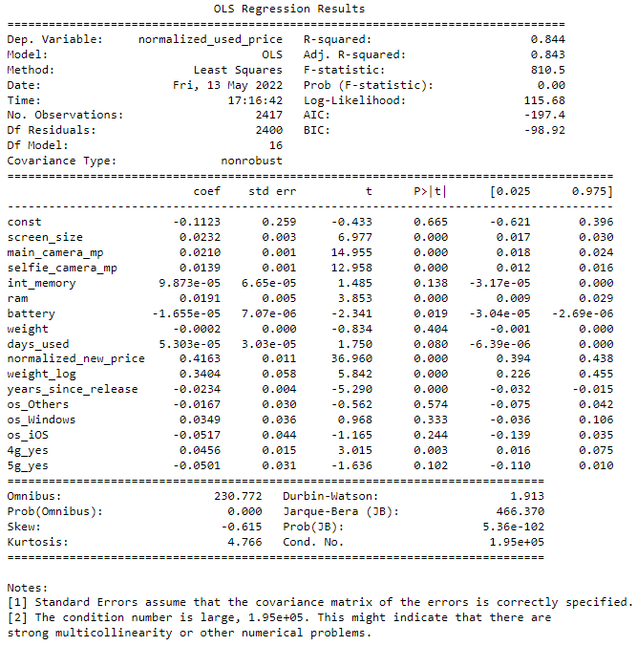
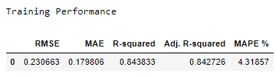

First OLS Model performance results

